Slide 1
APHELION MUSIC
MUSIC GENRE CLASSIFIER
ME781 COURSE PROJECT
Guide : Prof. Asim Tiwari
GROUP 5
SAI ANEESH SURYADEVARA | 190100125
ADITYA PANWAR | 203386003
PRASANNA TELAWNE | 18B030018
NAMAN GUPTA | 190010048

Slide 2
PROJECT OBJECTIVE
PRODUCT | We are a mumbai-based startup providing software solutions for audio analysis, music genre classification and mood categorization.
CUSTOMERS | We plan to enter the B2B market, with our advanced classification system and provide music streaming platforms a bigger opportunity to reach wider audiences and provide more customer satisfaction.
COMPETITORS | Spotify, SoundCloud, Apple Music, Youtube, Amazon Prime Music
AIM | At a time where we all have access to great music, we believe that every individual’s experience should be nothing short of extraordinary. Genres play a vital role in that. Our mission is to become the industry standard for music classification so that 100% of any music catalog is properly classified. Hence, enabling recommendation and discovery engines to be optimized and personalized for each individual user. It will also help artists to market their music in a way that distinguishes them from others.

Slide 3
PROBLEM DEFINITION
Customer Requirement | Any generic music streaming platform is estimated to have about 70 M+ songs. Even If it takes just 3 seconds to classify a song, It would be impractical to classify them all manually. No one wants to do that. Hence the need to automate the system.
Market Survey | Youtube Music (Recommendation system), Spotify (Music Recommender), Amazon Prime Music (Playlist for songs), Deezer (Songs player)
USP | Easy-to-use user friendly interface to classify the songs into their genres and moods. High Accuracy compared to available market. Exclusive training based on Indian songs. Mood classifiers not explored a lot.
Protecting USP | Code Encryption and secure and reliable transfer of data for the model. Patenting and Copyrighting the startup solution, keeping the code to us.
Barrier to Entry | Patents and Copyright issues from other companies in the field Automated algorithms already in place to classify Availability of large and dynamic training data to be used in the model
Structure | Upload of the songs to the server through a website -> Model extracts Music components through Music Information Retrieval (MIR) -> Model predicts the genre and the mood for the songs and bins it accordingly.

Slide 4
TECHNOLOGY LANDSCAPE ASSESSMENT
Patents | Music genre classification method and apparatus Music classification system and method
Published Literature | Automatic Music Genre Classification Based on Modulation Spectral Analysis of Spectral and Cepstral Features Automatic Genre Classification of Music Content Music Genre Classification using Machine Learning Algorithms: A comparison Music Genre Classification using Machine Learning Techniques Music Mood and Theme Classification - A Hybrid Approach Automatic Music Genre Classification using Convolutional Neural Network
Open Libraries | Python-based Implementation Primary libraries: NumPy, Librosa, pyAudioAnalysis, sklearn, Keras, Matplotlib, Essentia Secondary (IF needed): pySonic, SciPy (for audio filters), pydub (for conversion), libtsm (pitch and time-scale), aubio (live audio), Sync Toolbox
Proprietary Libraries + Dataset | madmom, FMOD GTZAN, MTG

Slide 5
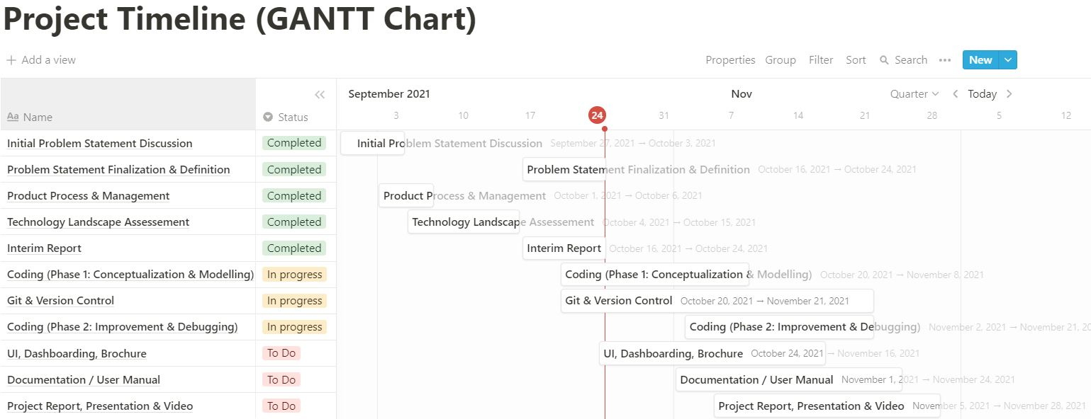
PROJECT PLAN

Slide 6
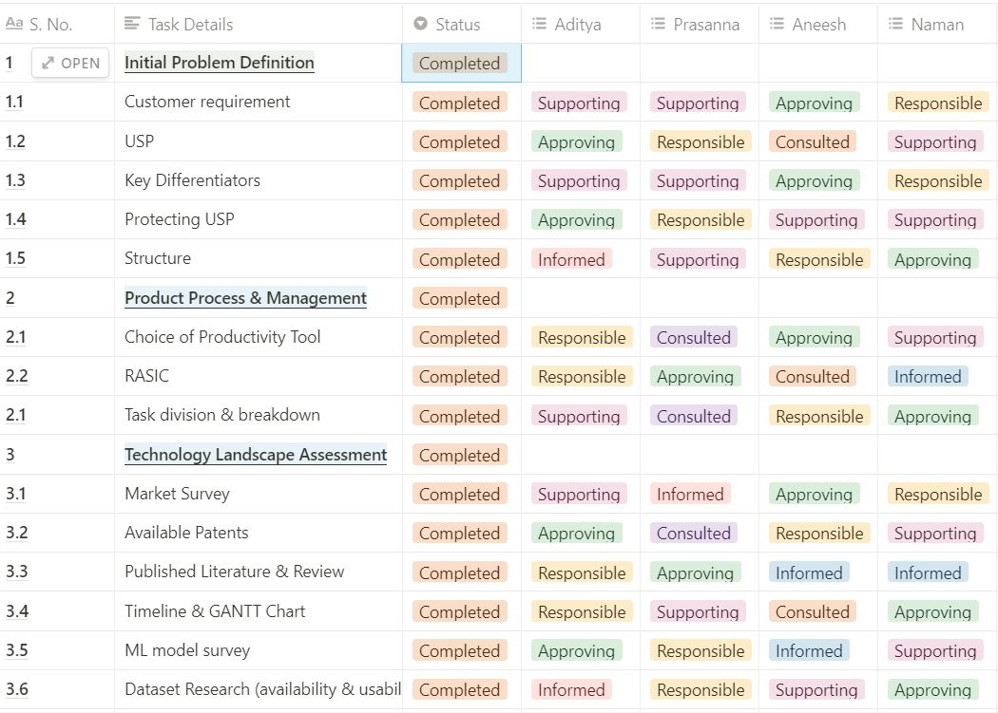
RASIC Matrix
Tool: Notion
Rules:
One R each row (task)
One A each row (task)
Status: In Progress, To Do or Completed
Find more here:
RASIC Group 5

Slide 7
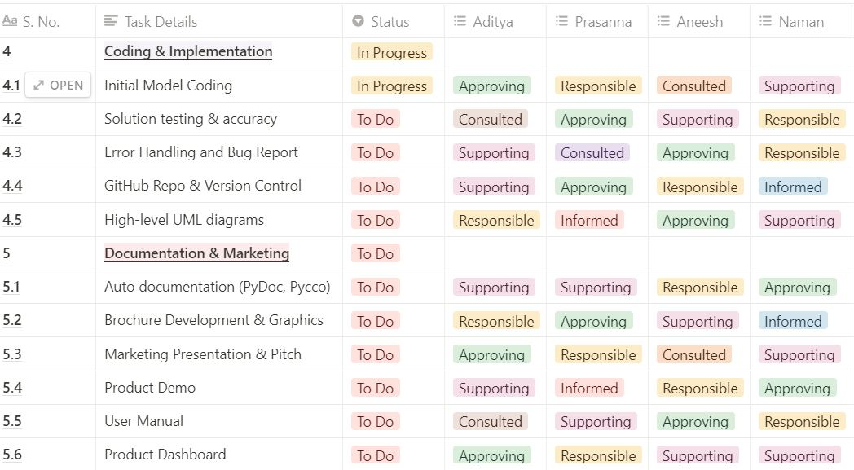
Continuation of previous slide’s RASIC chart

Slide 8
THANKS!

